Slide 1
Data Abstraction and Object Orientation Data Abstraction and Object Orientation
Sabrina Tarin Chowdhury

Slide 2
Object-Oriented Programming
Control or PROCESS abstraction (subroutines!) is a very old idea
Data abstraction (Object-Oriented (OO)) is somewhat newer
An Abstract Data Type is one that is defined in terms of the operations that it supports (i.e., that can be performed upon it) rather than in terms of its structure or implementation

Slide 3
Object-Oriented Programming
Why abstractions?
easier to think about - hide what doesn't matter
protection - prevent access to things you shouldn't see
plug compatibility
replacement of pieces, often without recompilation, definitely without rewriting libraries
division of labor in software projects

Slide 4
Object-Oriented Programming
The 3 key factors in OO programming
Encapsulation (data hiding)
Inheritance
Dynamic method binding
Languages that supports OOP
Basic Fortran
Fortran, Algol 60, C
Modula-2, Ada 83
Euclid
Smalltalk, C++, Eiffel, Java Oberon, Modula-3, Ada 95
Types of OO
Imperative OO (C++, Java, C#, Python, etc.)
Functional OO (Ocaml, CLOS, etc.)
Logical OO (Flora-2)

Slide 5
Object-Oriented Programming
Benefits of OOP:
Reduced Conceptual Load
Give a concept a name
Fault containment
Object can enforce an interface that must be followed
Independence
Reusability

Slide 6
Object-Oriented Programming
The language needs a way of defining a class:
Name,
Superclasses (incl. Interfaces),
Fields : data definitions
Methods : Member functions
Fields + Methods = Members of the class
Note: classes do not need to be defined in a single file:
C++ allows a definition to be split up over multiple files,
Java allows more than one class per file (one is public)

Slide 7
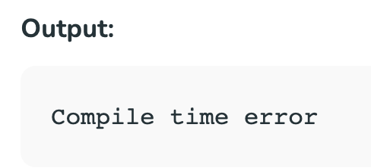
Protection
// Java program to illustrate default modifier
package p1;
// Class Test is having Default access modifier
class Test
{
void display()
{
System.out.println("Hello World!");
}
}
OO supports data hiding / protection:
Keep implementation details from leaking into the larger program.
The 4 kinds of Visibility protection in Java:
Public
Protected
Default (visible to classes in same module/package)
Private
Others are possible: C++ has Friend
// Java program to illustrate error while using class //from different package with default modifier
package p2;
import p1.*;
// This class is having default access modifier
class TestNew
{
public static void main(String args[])
{
// Accessing class Test from package p1
Test obj = new Test();
obj.display();
}
}

Slide 8
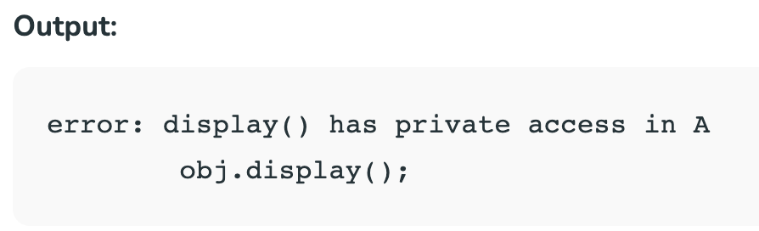
Protection
// Java program to illustrate error while
// using class from different package with
// private modifier
package p1;
class A
{
private void display()
{
System.out.println(”Hello World");
}
}
class B
{
public static void main(String args[])
{
A obj = new A();
// Trying to access private method
// of another class
obj.display();
}
}
C++
Private - members cannot be accessed (or viewed) from outside the class. Protected - members cannot be accessed from outside the class, however, they can be accessed in inherited classes.
Java
- The private modifier specifies that the member can only be accessed in its own class. The protected modifier specifies that the member can only be accessed within its own package (as with package-private) and, in addition, by a subclass of its class in another package.

Slide 9
Protection
// Java program to illustrate protected modifier
package p2;
import p1.*; // importing all classes in package p1
// Class B is subclass of A
class B extends A
{
public static void main(String args[])
{
B obj = new B();
obj.display();
}
}
// Java program to illustrate protected modifier package p1; // Class A public class A { protected void display() { System.out.println(”Hello World!!!"); } }
Output : Hello World!!!

Slide 10
Protection
A C++ friend class: in C++ can access the "private" and "protected" members of the class in which it is declared as a friend:
class B {
friend class A; // A is a friend of B private:
int i;
};
class A {
public:
A(B b) { // the object has to be passed as a parameter to the function
b.i = 0; // legal access due to friendship
}
};

Slide 11
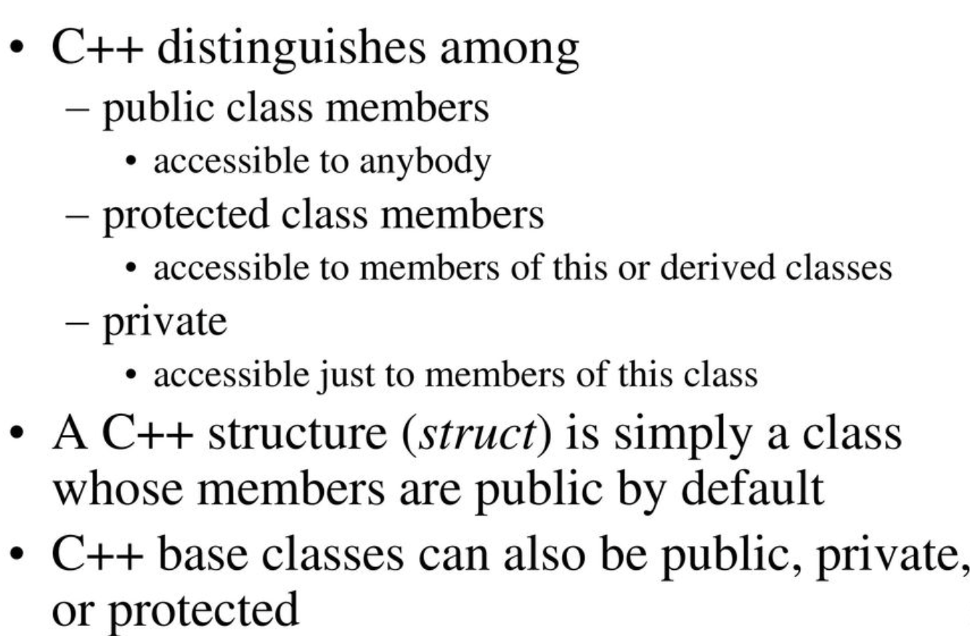
Encapsulation and Inheritance Classes (C++)

Slide 12
Encapsulation and Inheritance
Example:
class circle : public shape { ...
anybody can convert (assign) a circle* into a shape*
class circle : protected shape { ...
only members and friends of circle or its derived classes can convert (assign) a circle* into a shape*
class circle : private shape { ...
only members and friends of circle can convert (assign) a circle* into a shape*

Slide 13
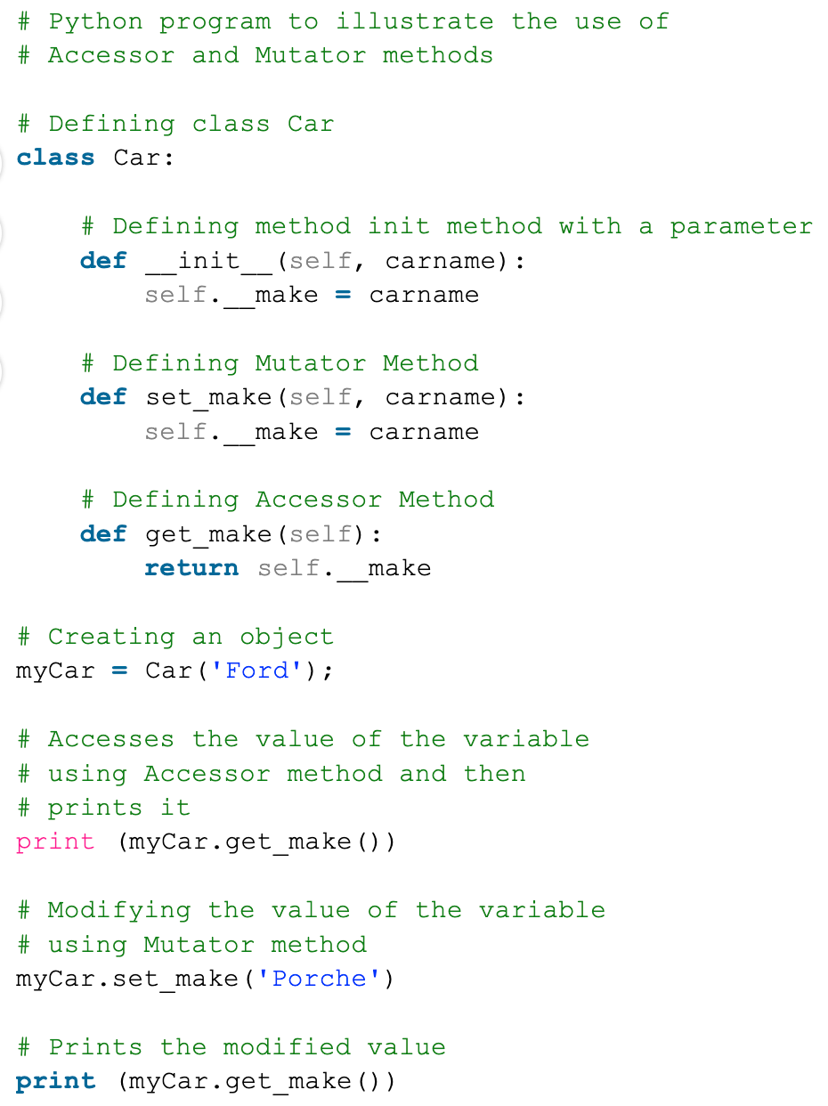
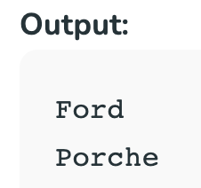
Accessors
Field access is bad in OOP: allows an external program to change any value.
Accessors: small subroutines that are used to access.
constrain how we can change our implementation.
getters + setters = accessors and mutators for all the fields.
Less convenient than fields, but preferred for safety.
Good compromise: declare properties, which look like fields, but invoke methods (C#, Python).

Slide 14
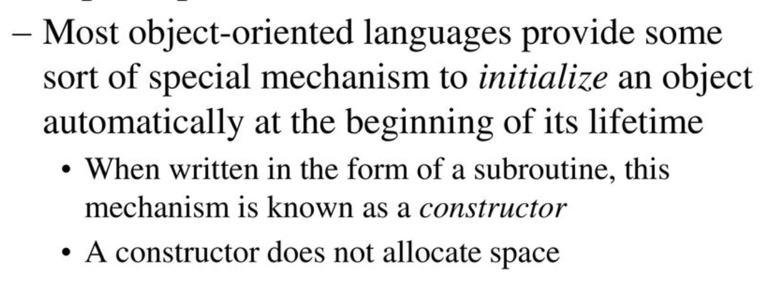
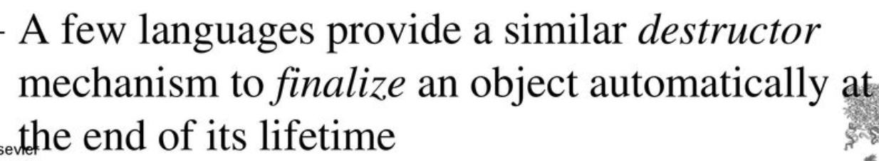
Initialization and Finalization
Lifetime of an object:
-Interval during which it occupies space and can hold data

Slide 15
Constructors and Destructors
In languages where objects are values, those values need to be initialized as part of our constructor. (By calling their constructor.)
class A {
A () { …. }
}
Constructor function is called automatically when an object of that class is created.
int main(){
A obj; }
Destructors:
Called when an object goes away, to free up resourced used by it.

Slide 16
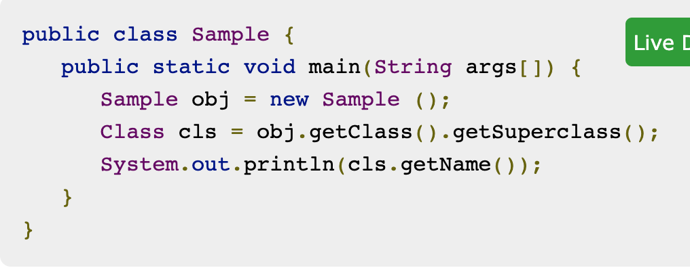
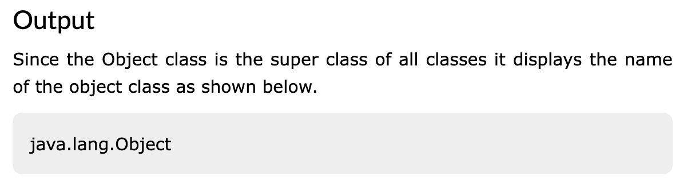
Inheritance
We can create a subclass that inherits from a superclass.
Inherits fields and methods from base class.
Do we need a root class?
C++ is fine without it.
Java, Smalltalk, C#, etc have one.
The Object class of the java.lang package is the root class in Java i.e. It is the super class of every user-defined/predefined class n Java. All objects, including arrays, implement the methods of this class.

Slide 17
Multiple Inheritance
In C++, you can say
class professor : public teacher, public researcher {
...
}
Here you get all the members of teacher and all the members of researcher
If there's anything that's in both (same name and argument types), then calls to the member are ambiguous; the compiler disallows them

Slide 18
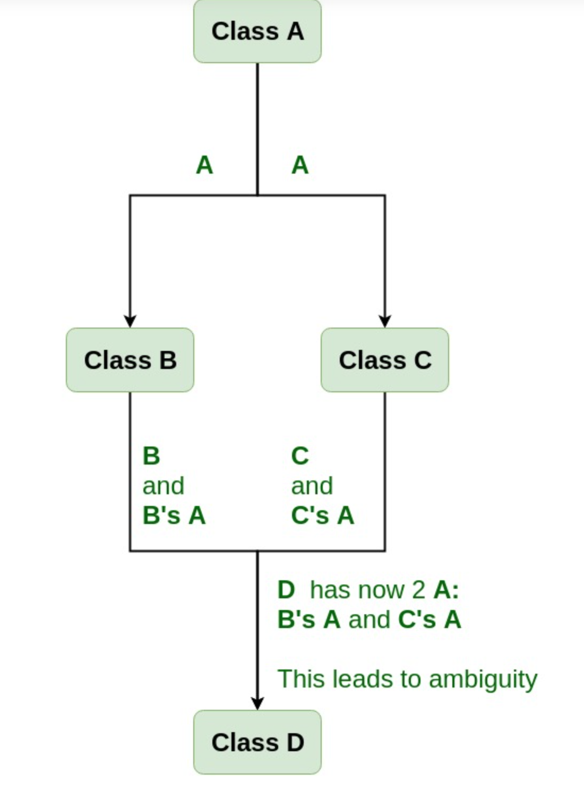
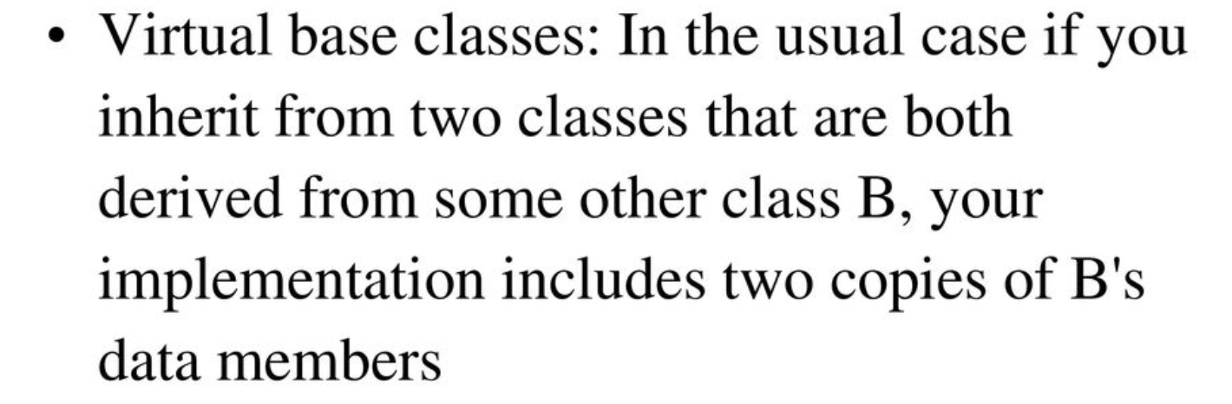
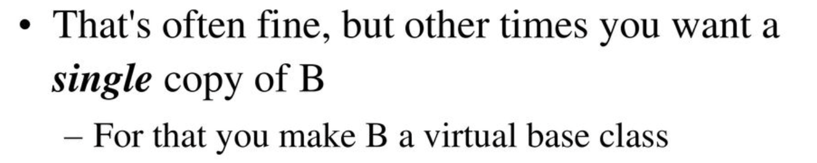
Multiple Inheritance
A
A’s
A

Slide 19
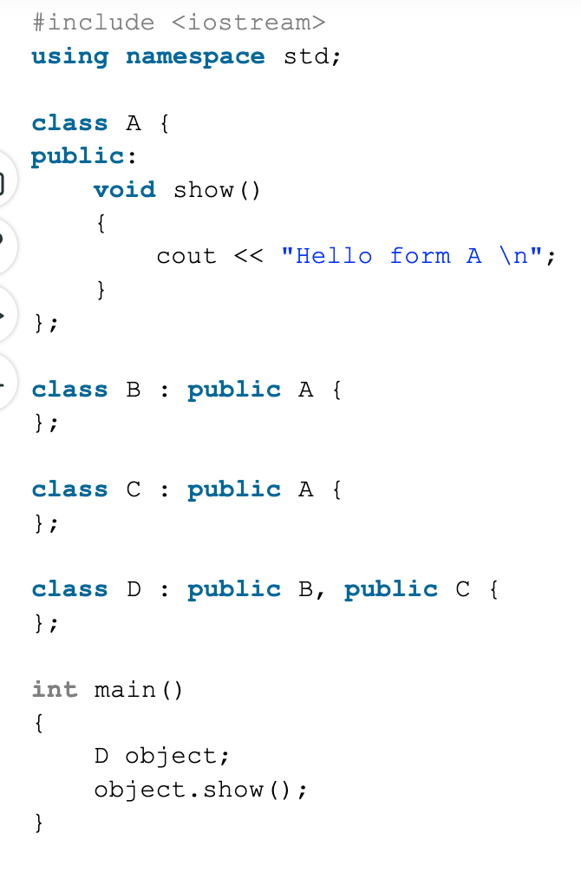
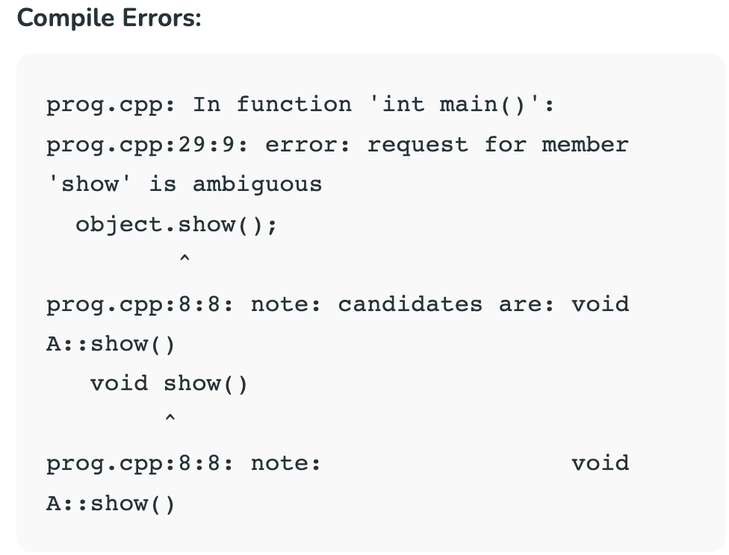
Virtual Base Class

Slide 20
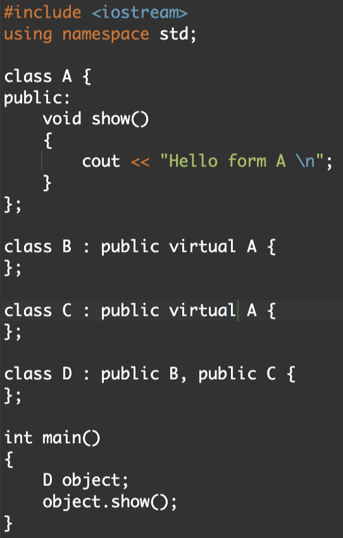

Virtual Base Class

Slide 21
Nested Inner Classes
Inner Class = class defined inside another class:
Need to decide which fields such a class sees
Nothing - no special relationship to outer class (Python)
Statics Only (C++/C#).
Associated with every instance (Java)
Needs link to instance of enclosing class.

Slide 22
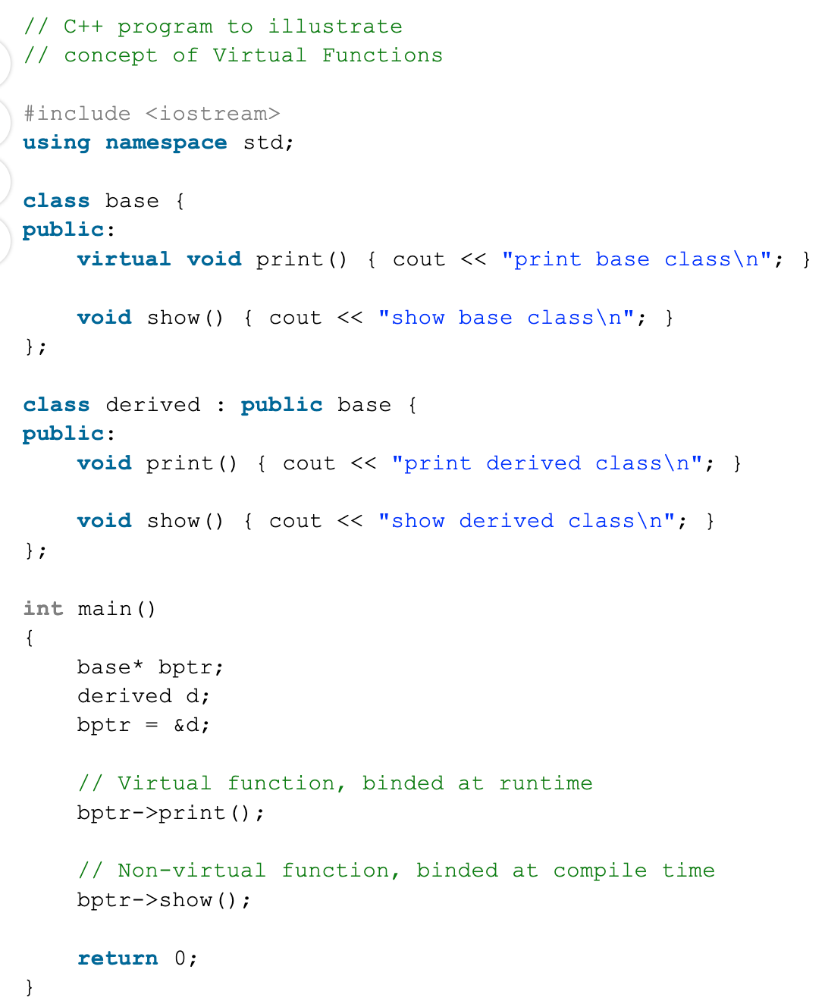
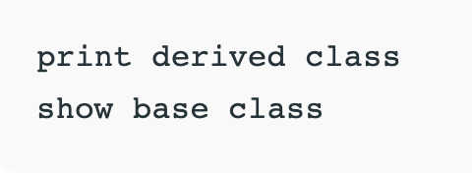
Dynamic Method Binding
A virtual function (also known as virtual methods) is a member function that is declared within a base class and is re-defined (overridden) by a derived class.
Output

Slide 23
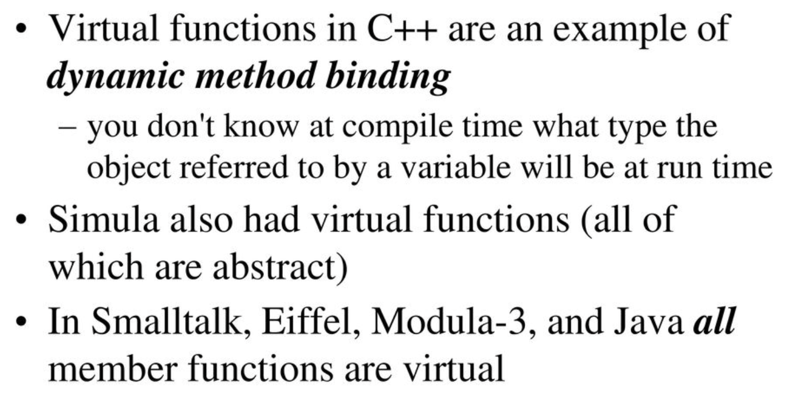
Dynamic Method Binding
Subtype polymorphism:
class C: def foo(): ...
class D(C): def foo(): ...
When both define method foo, which method do we call:
static method binding - needs static typing - call method
dynamic method binding - use class of the object - call from most derived type → more expensive.
Dynamic == virtual methods in C++.
Dynamic == default in Java.

Slide 24
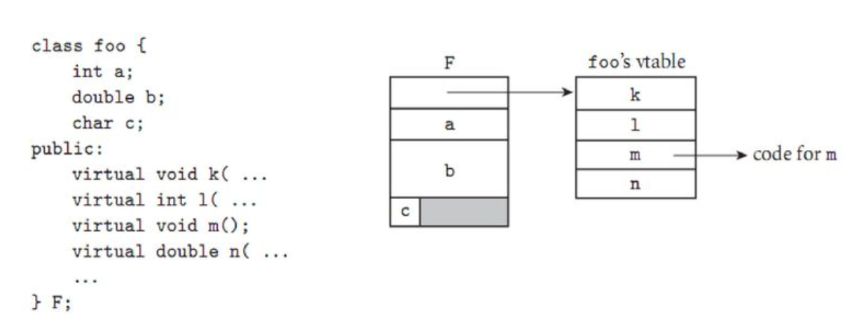
Dynamic Method Binding
The representation of object F begins with the address of the vtable for class foo.
All objects of this class will point to the same vtable.
The vtable itself consists of an array of addresses, one for the code of each virtual method of the class.
The remainder of F consists of the representations of its fields.

Slide 25
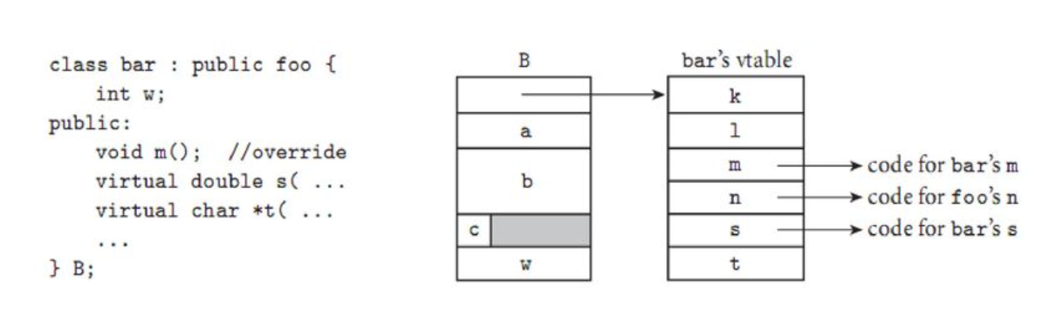
Dynamic Method Binding
The representation of object B begins with the address of its class’s vtable. The first four entries in the table represent the same members as they do for foo, except that one—m—has been overridden and now contains the address of the code for a different subroutine. Additional fields of bar follow the ones inherited from foo in the representation of B; additional virtual methods follow the ones inherited from foo in the vtable of class bar.

Slide 26
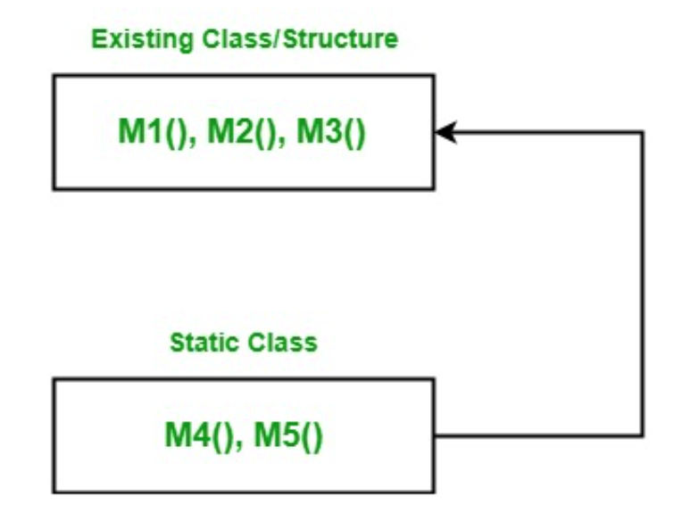
Extension Methods
using System;
namespace ExtensionMethod {
// Here Test class contains three methods
// Now we want to add two more new methods in it
// Without re-compiling this class
class Test {
// Method 1
public void M1()
{
Console.WriteLine("Method Name: M1");
}
// Method 2
public void M2()
{
Console.WriteLine("Method Name: M2");
}
// Method 3
public void M3()
{
Console.WriteLine("Method Name: M3");
}
}
}
The extension method concept allows you to add new methods in the existing class or in the structure without modifying the source code of the original type and you do not require any kind of special permission from the original type and there is no need to re-compile the original type. It is introduced in C# 3.0
Program1.cs
First we create a class named as Test in Program1.cs file. It contains three methods that is M1(), M2(), and M3().

Slide 27
Extension Methods
// C# program to illustrate the concept
// of the extension methods
using System;
namespace ExtensionMethod {
// This class contains M4 and M5 method
// Which we want to add in Test class.
// NewMethodClass is a static class
static class NewMethodClass {
// Method 4
public static void M4(this Test g)
{
Console.WriteLine("Method Name: M4");
}
// Method 5
public static void M5(this Test g, string str)
{
Console.WriteLine(str);
}
}
// Now we create a new class in which
// Test class access all the five methods
public class GFG {
// Main Method
public static void Main(string[] args)
{
Test g = new Test();
g.M1();
g.M2();
g.M3();
g.M4();
g.M5("Method Name: M5");
}
}
}
Now we create a static class named as NewMethodClass in Program2.cs file. It contains two methods that are M4() and M5(). Now we want to add these methods in Test class,
Program2.cs

